Slide 1
Application of Neural Networks in Smoothing Handwriting
Muchigi Kimari, Edward Fry, Ikenna Nwaogu, YuMei Bennett
Advisor : John Santerre
Feb12, 2021
DataScience@SMU

Slide 2


Problem Statement
Background
Data
Methods
Results
Ethical Discussion
Conclusions
Questions
Citations
DataScience@SMU Feb12, 2021

Slide 3
Problem Statement
DataScience@SMU Feb 12, 2021

Slide 4
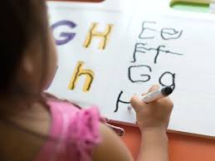

Problem Statement
Dysgraphia is Motor disorder
Difficult expressing ideas on paper

Slide 5
Background
DataScience@SMU Feb 12, 2021

Slide 6
Symptoms of Dysgraphia
Illegible handwriting
Difficulty drawing
Spelling errors
Tight hold on pen
Omitting letters and words from sentences
Trouble filling
Mixing of lowercase and uppercase letters
Often leaves out individual letters
Able to explain self clearly when speaking but not when writing

Slide 7


What causes dysgraphia?
Orthographic coding
When is handwriting needed?
DataScience@SMU Feb 12, 2021

Slide 8
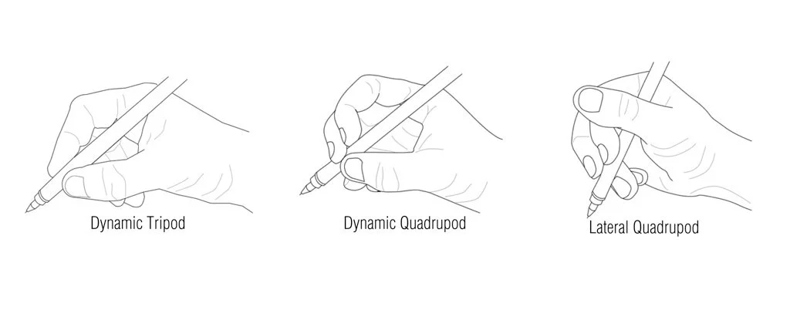
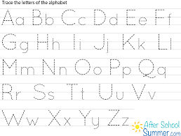
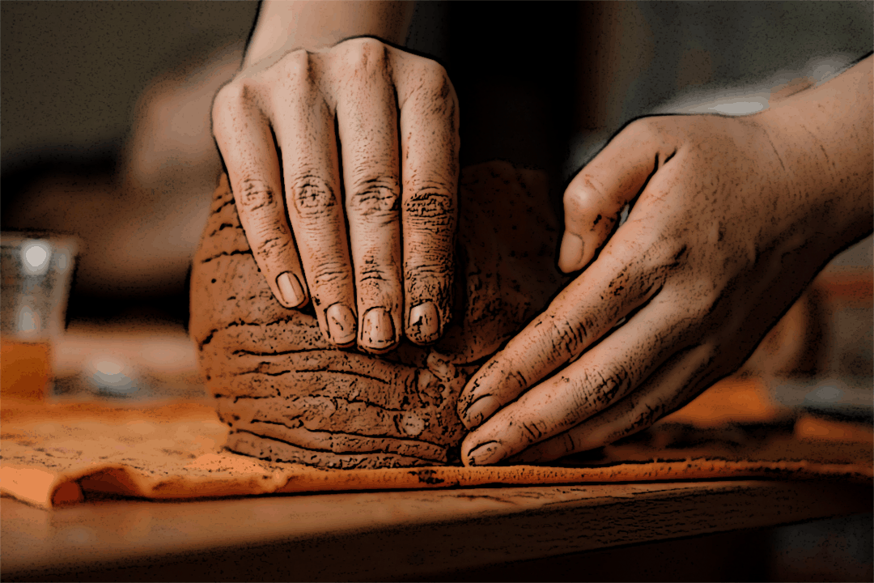
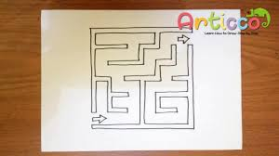
There is no cure for dysgraphia
Therapeutic activities may include:
DataScience@SMU Feb 12, 2021

Slide 9

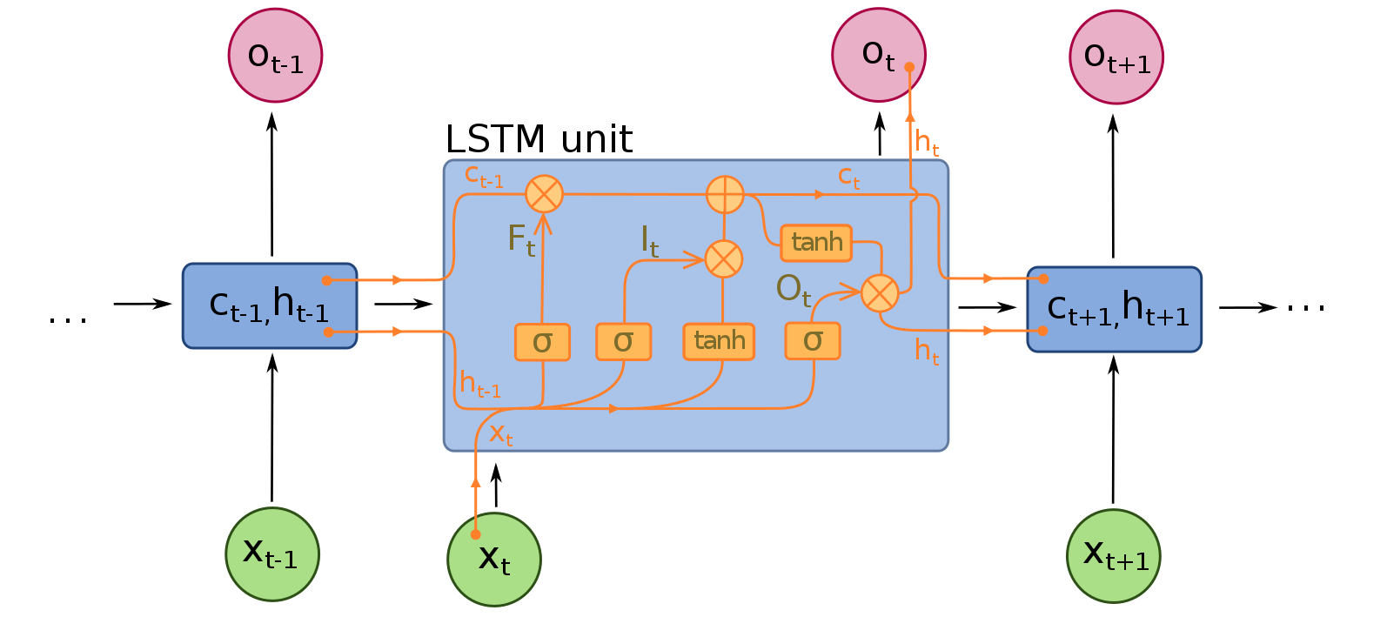
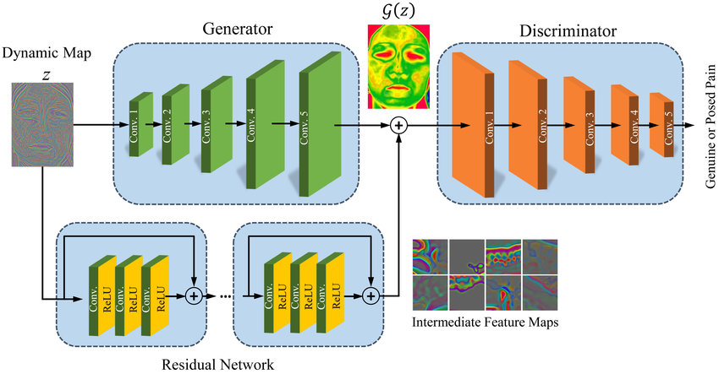
So what is the solution?
LSTM
Generative Adverserial Network

Slide 10
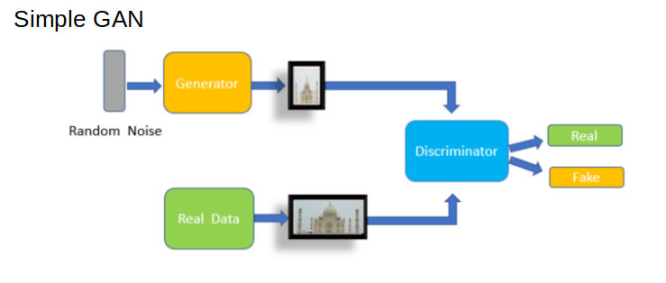
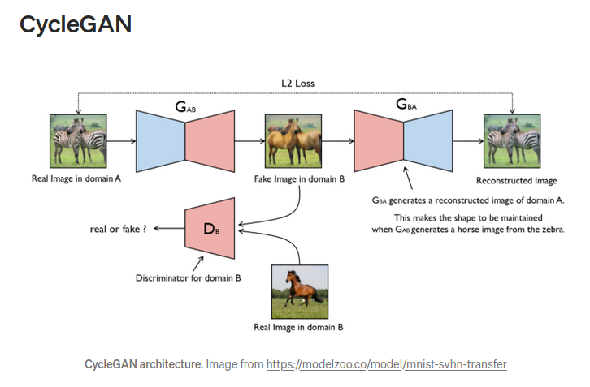
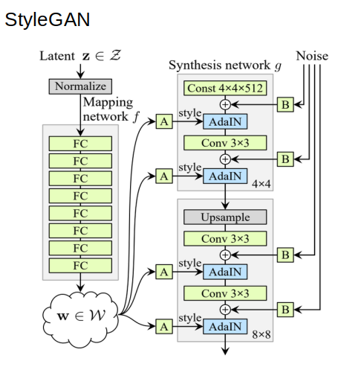
Generative Adversarial Networks
GAN Overview
10

Slide 11
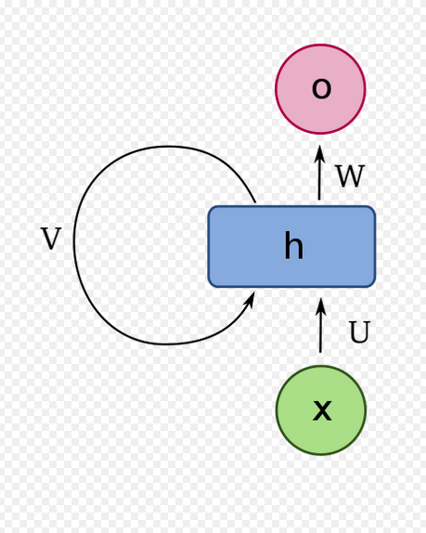
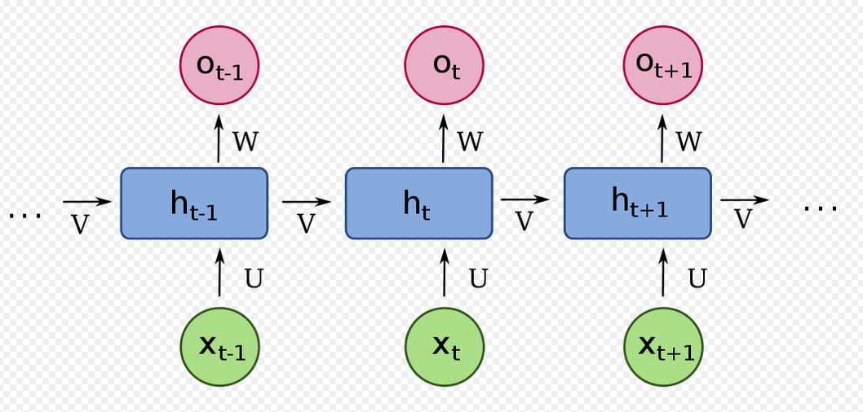
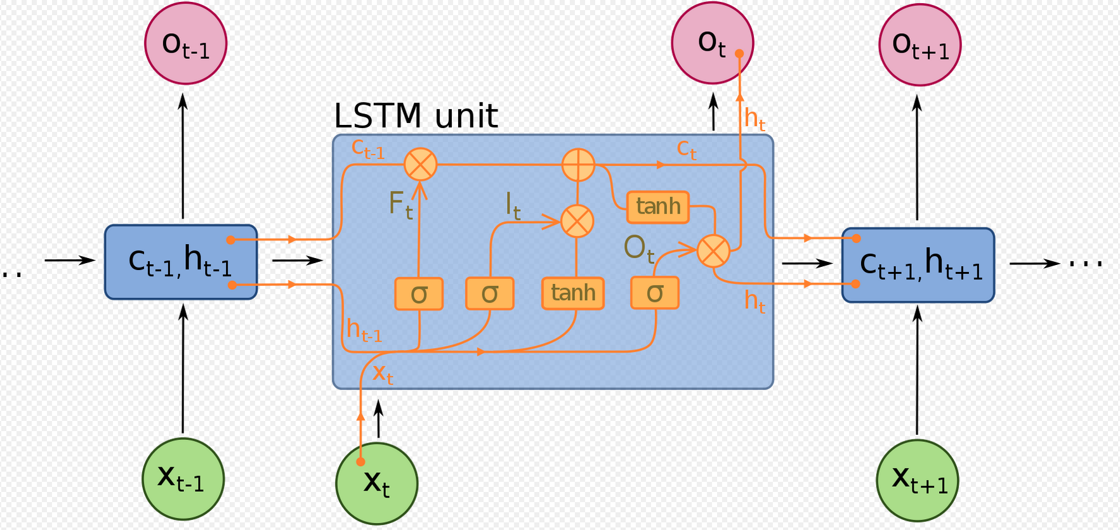
Long Short-Term Memory
RNN Overview
11
DataScience@SMU Feb 12, 2021

Slide 12
DATA
The following data sources were considered.
EMNIST Dataset
IAM Handwriting Top50
Yu Qiao
A-Z Handwritten Alphabets(https://www.nist.gov/srd/nist-special-database-19)
12
DataScience@SMU Feb 12, 2021

Slide 13
Methods
DataScience@SMU Feb 12, 2021

Slide 14




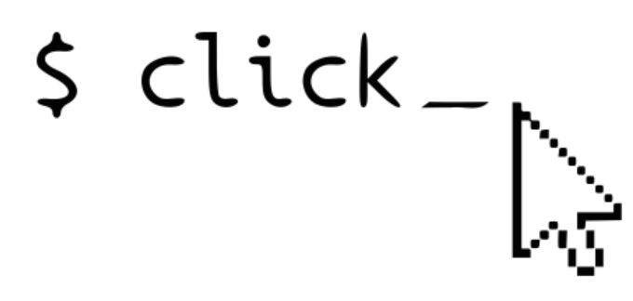

Tools and Utilities
DataScience@SMU Feb 12, 2021

Slide 15
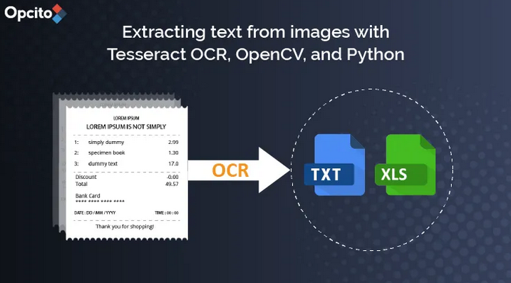
Generative Adversarial Network
Step 1 – Load data
Step 2 – Build GAN Model
Step 3 – Train
Step 4 – Prediction
15
A-Z Handwritten Alphabets
The dataset contains 26 folders (A-Z) containing handwritten images in size 2828 pixels, each alphabet in the image is center fitted to 2020 pixel box.

Slide 16
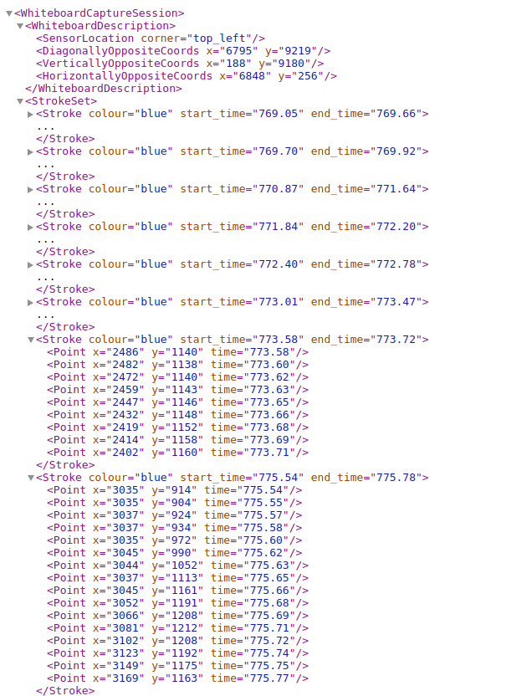
Data Structure
IAM Handwriting Top50
Stroke Dataset
16
Stroke Set
Stroke
Point

Slide 17
LSTM Training
Step 1 – Load data
LSTMDataInterface is a function
Step 2 – Build LSTM
Our LSTM model comprises of:
A GRU function from pytorch
A linear layer for classification
A SoftMax and entropy loss
Step 3 – Train
Step 4 – Prediction

Slide 18
Results
DataScience@SMU Feb 12, 2021

Slide 19
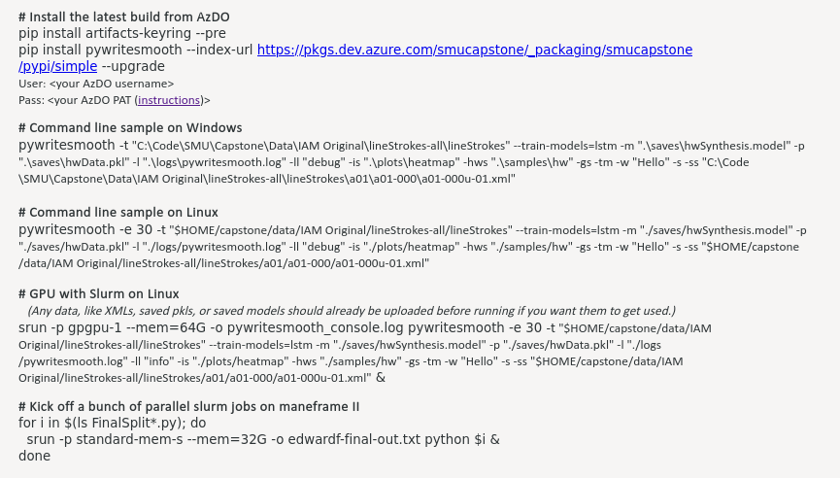
Final Product
19
DataScience@SMU Feb 12, 2021

Slide 20
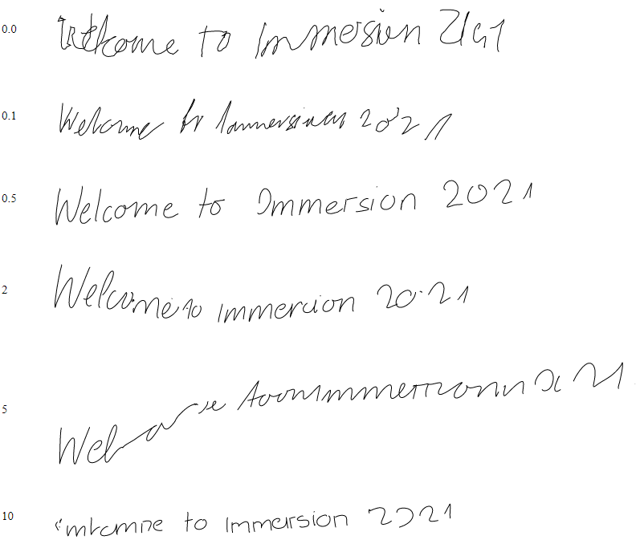

Slide 21
Discussion/ Ethical
DataScience@SMU Feb 12, 2021

Slide 22
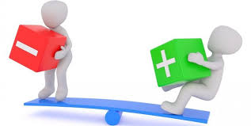
Discussion/Ethical

Slide 23
Conclusions
DataScience@SMU Feb 12, 2021

Slide 24
Conclusion
The aim for this application is to help people impacted by Dysgraphia to communicate better
We hope that this application will promote additional research

Slide 25

THANKS!
Any questions?

Slide 26
Citations
DataScience@SMU Feb 12, 2021

